Slide 1
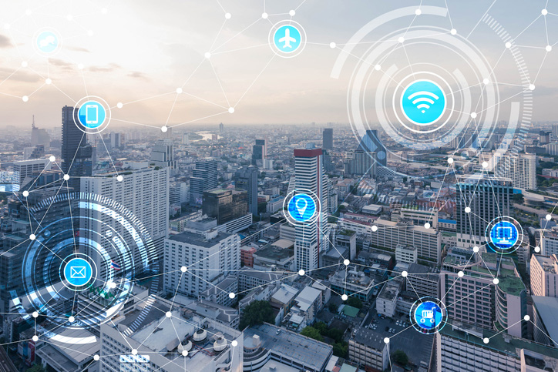
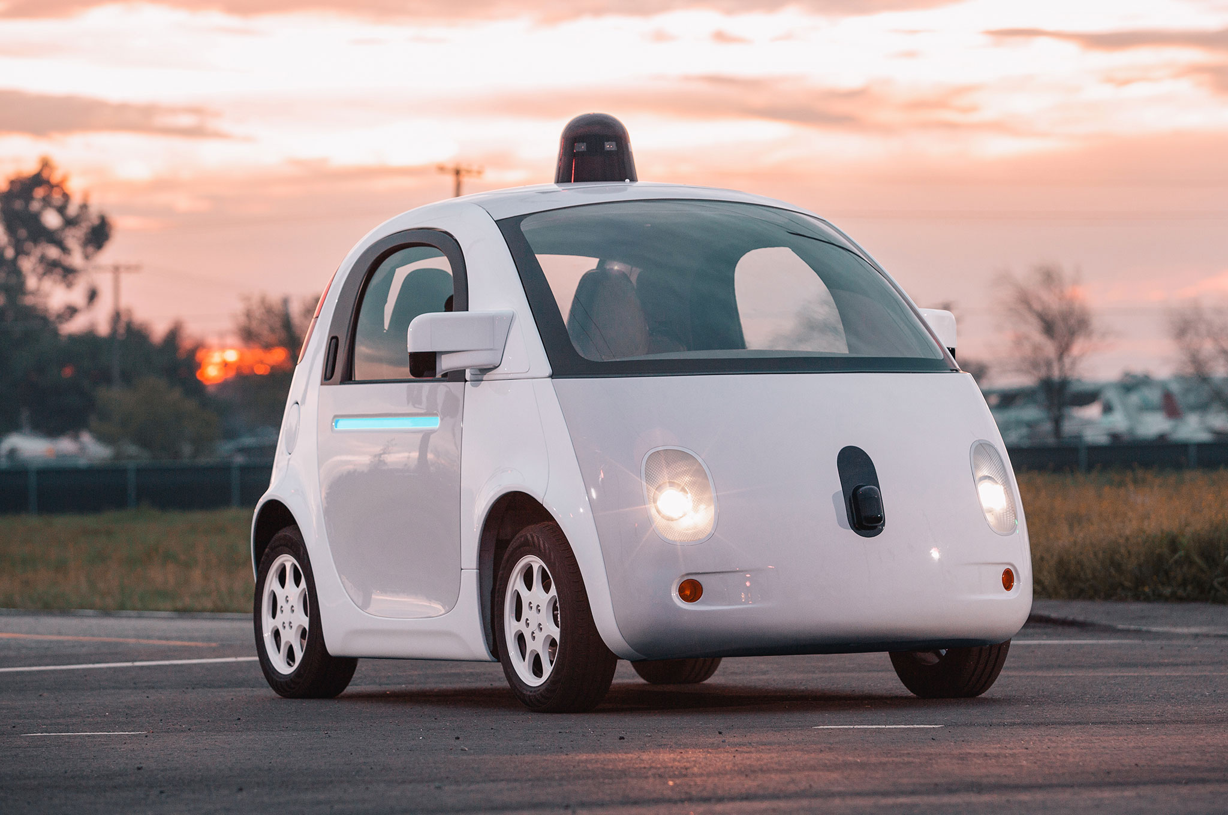

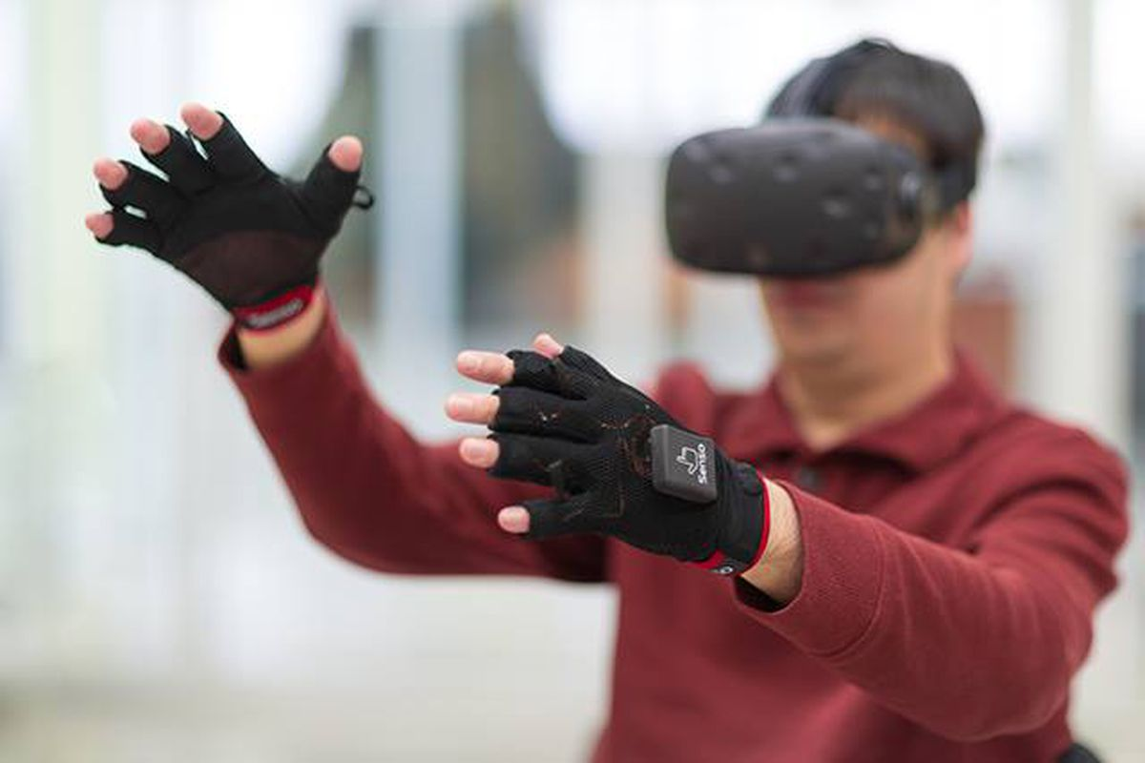

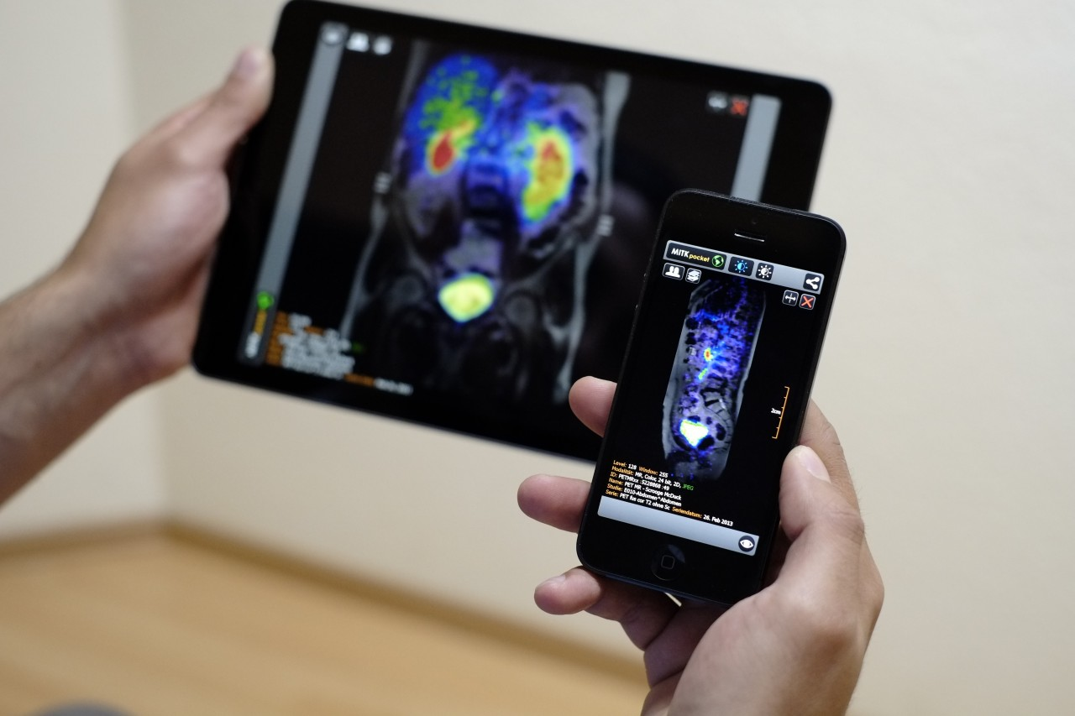
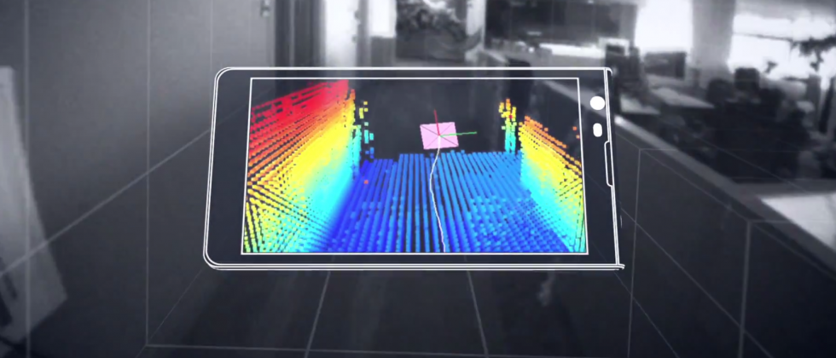
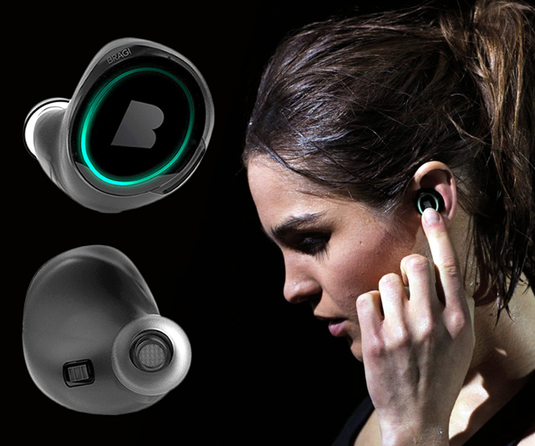
IoT and applications
Lecture 3.6: Deep Learning for IoT- Part 4

Slide 2
Deep Learning refresher

Slide 3
b₁
i₁
w₁
h₁
w₅
w₂
O₁
b₂
w₃
w₆
i₂
w₄
h₂
Input layer
Hidden layer
Output layer
Ref: https://hmkcode.com/ai/backpropagation-step-by-step/

Slide 4
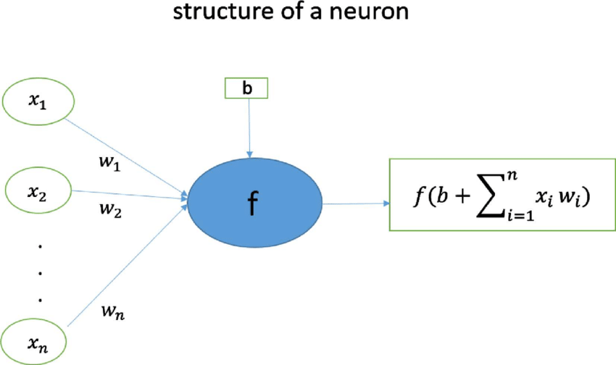
Structure of a neuron

Slide 5
b₁
i₁
w₁
h₁
w₅
w₂
O₁
b₂
w₃
w₆
i₂
w₄
h₂
For simplicity:
Set bias terms to zero.
Activation function: f(z) = z

Slide 6
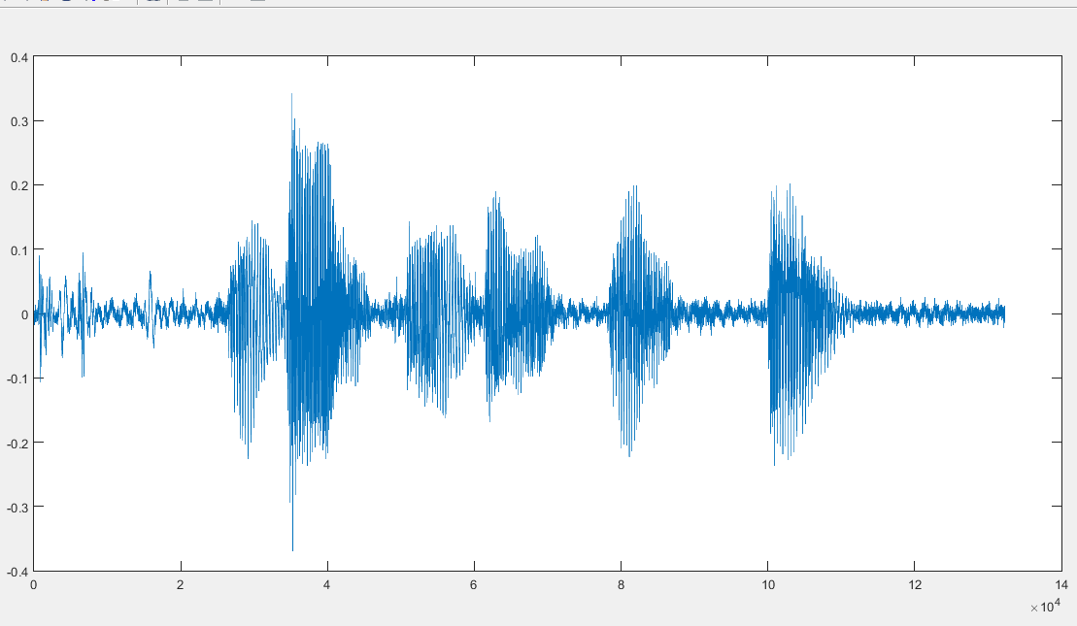

Forward propagation
i₁
w₁
h₁
w₅
w₂
[4.5, 0.8, 2.2, 9.1]
O₁
w₃
w₆
i₂
w₄
h₂
Prediction
Loss = ½(Actual output - prediction)²
Optimization: Adjust parameters to minimize loss

Slide 7
Back propagation
i₁
w₁
h₁
w₅
w₂
O₁
w₃
w₆
i₂
w₄
h₂
Prediction
Loss = ½(Actual output - prediction)²
Optimization: Adjust parameters to minimize loss

Slide 8
i₁
w₁
h₁
w₅
w₂
O₁
w₃
w₆
i₂
w₄
h₂
An example:
Input: i₁=2, i₂=3
Actual output = 1

Slide 9
2
w₁
h₁
w₅
w₂
O₁
w₃
w₆
Actual output = 1
3
w₄
h₂
An example:
Input: i₁=2, i₂=3
Actual output = 1

Slide 10
Start with random parameters
2
w₁
h₁
w₅
w₂
O₁
w₃
w₆
Actual output = 1
3
w₄
h₂

Slide 11
Start with random parameters
2
0.11
h₁
0.21
0.14
O₁
0.12
0.15
Actual output = 1
3
h₂
0.08
Forward propagation:
0.11
0.12
[
2
3
]
=
[
0.85
0.48
]
0.21
0.08

Slide 12
Start with random parameters
2
0.11
0.85
0.21
0.14
O₁
0.12
0.15
Actual output = 1
3
0.48
0.08
Forward propagation:
h₁
h₂
0.14
O₁
0.11
0.12
=
[
]
[
2
3
]
=
[
0.85
0.48
]
0.191
0.21
0.08
0.15

Slide 13
Start with random parameters
2
0.11
0.85
0.21
0.14
O₁
0.12
0.15
Actual output = 1
3
0.48
0.08
Error/Loss calculation:
O₁
Actual output = 1
1/2(
0.191
-
1
)²
=
0.327

Slide 14
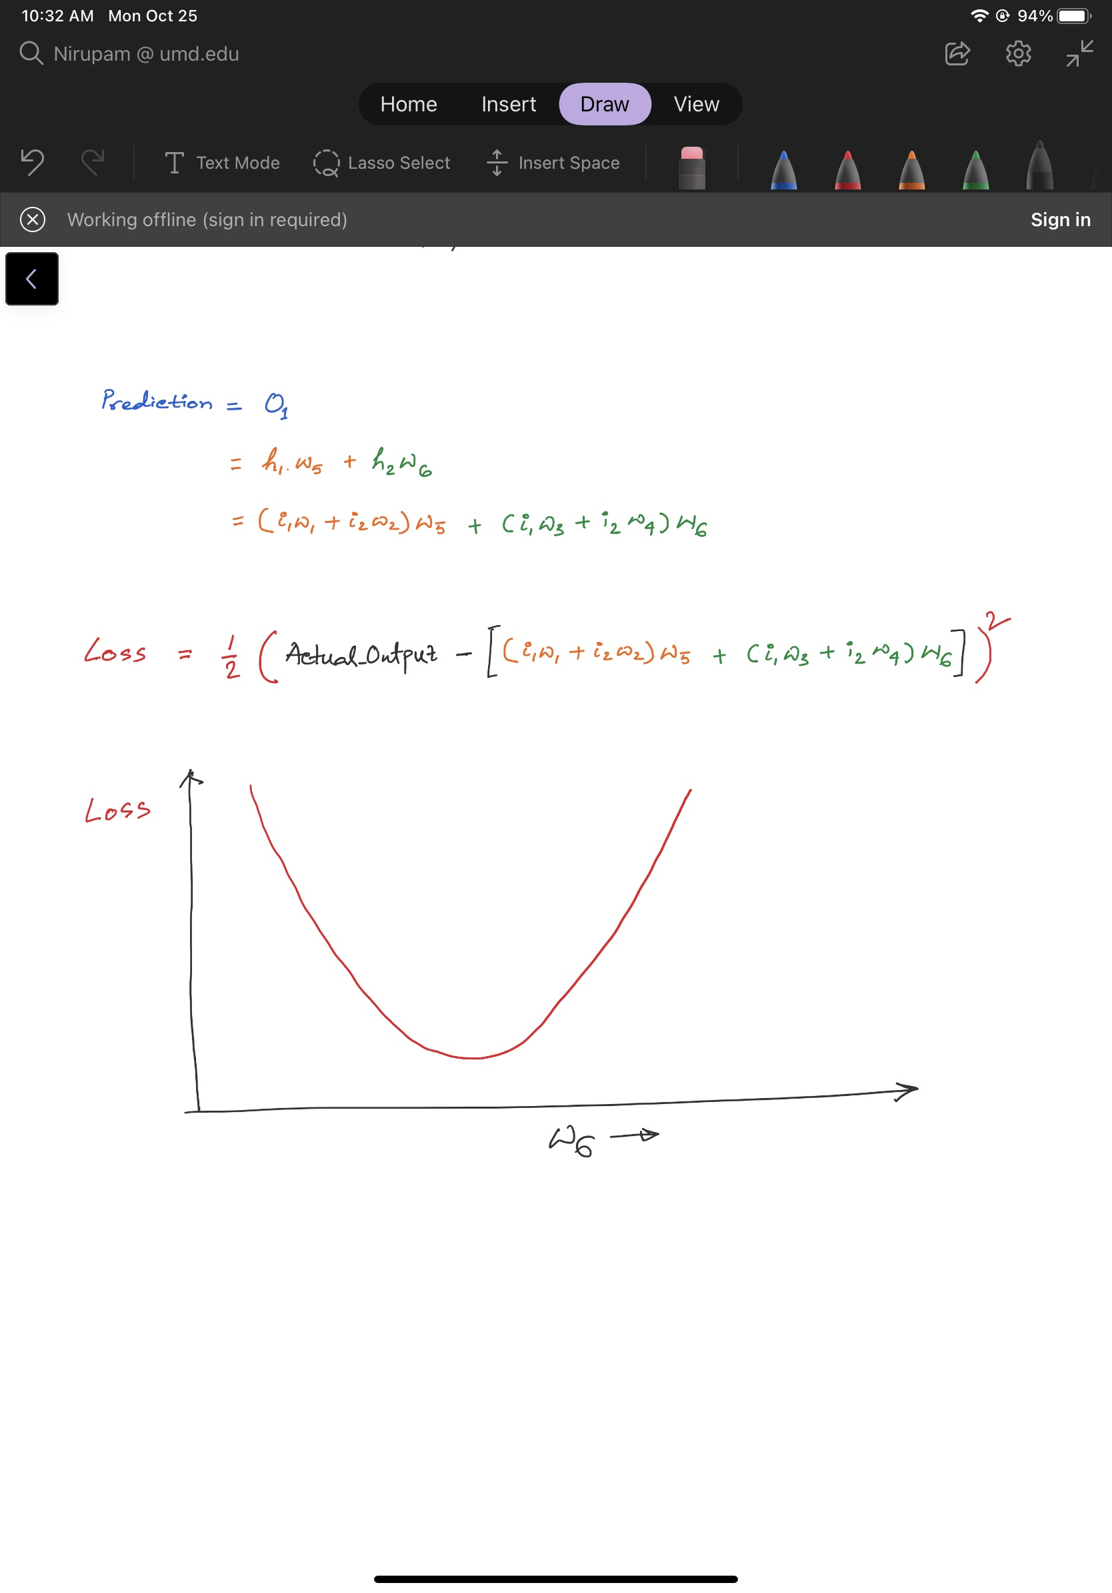
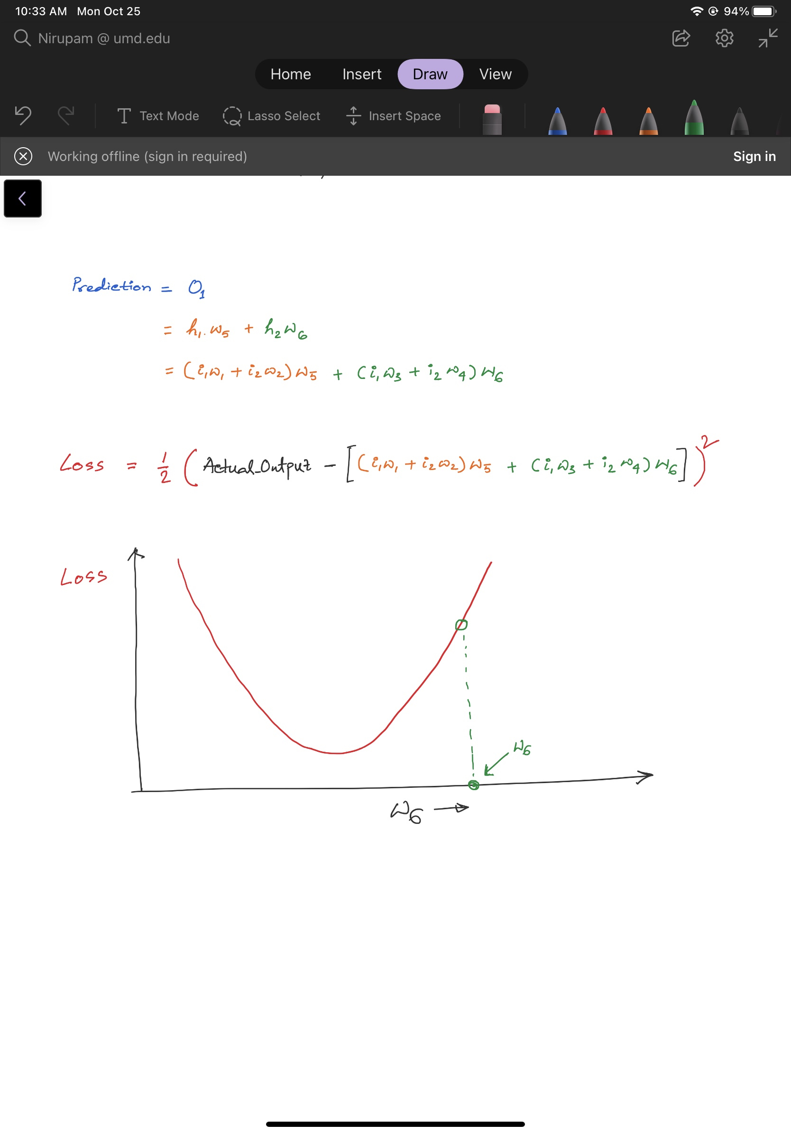
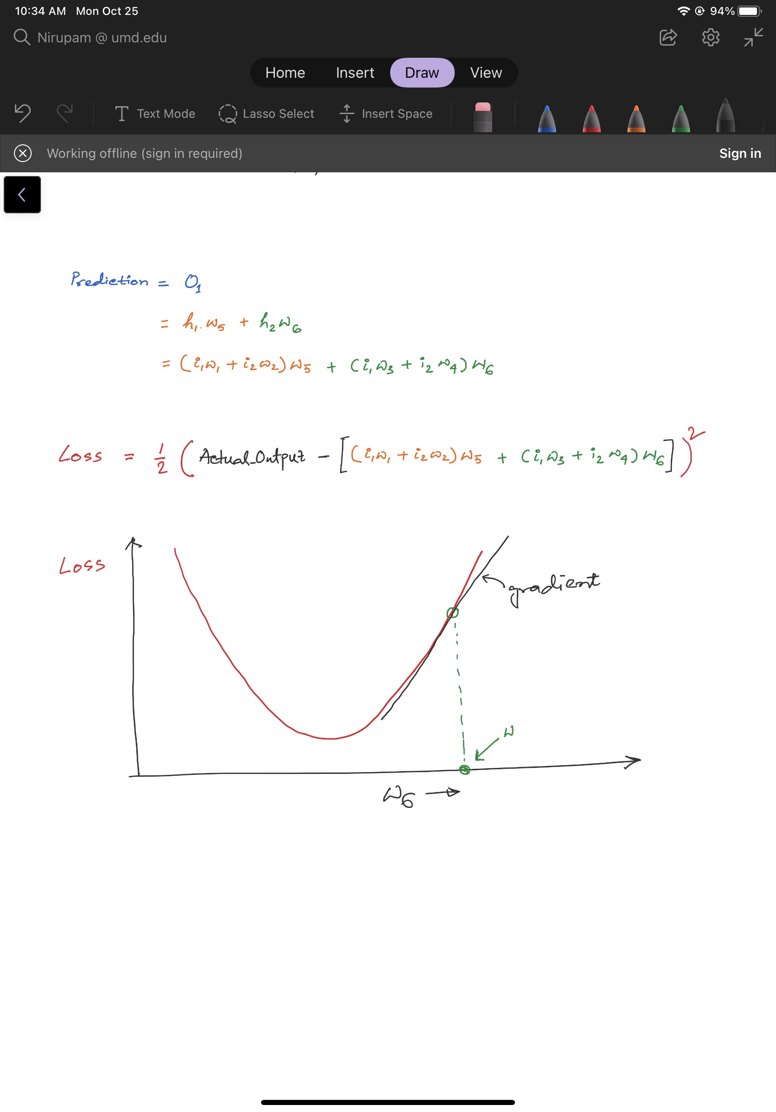
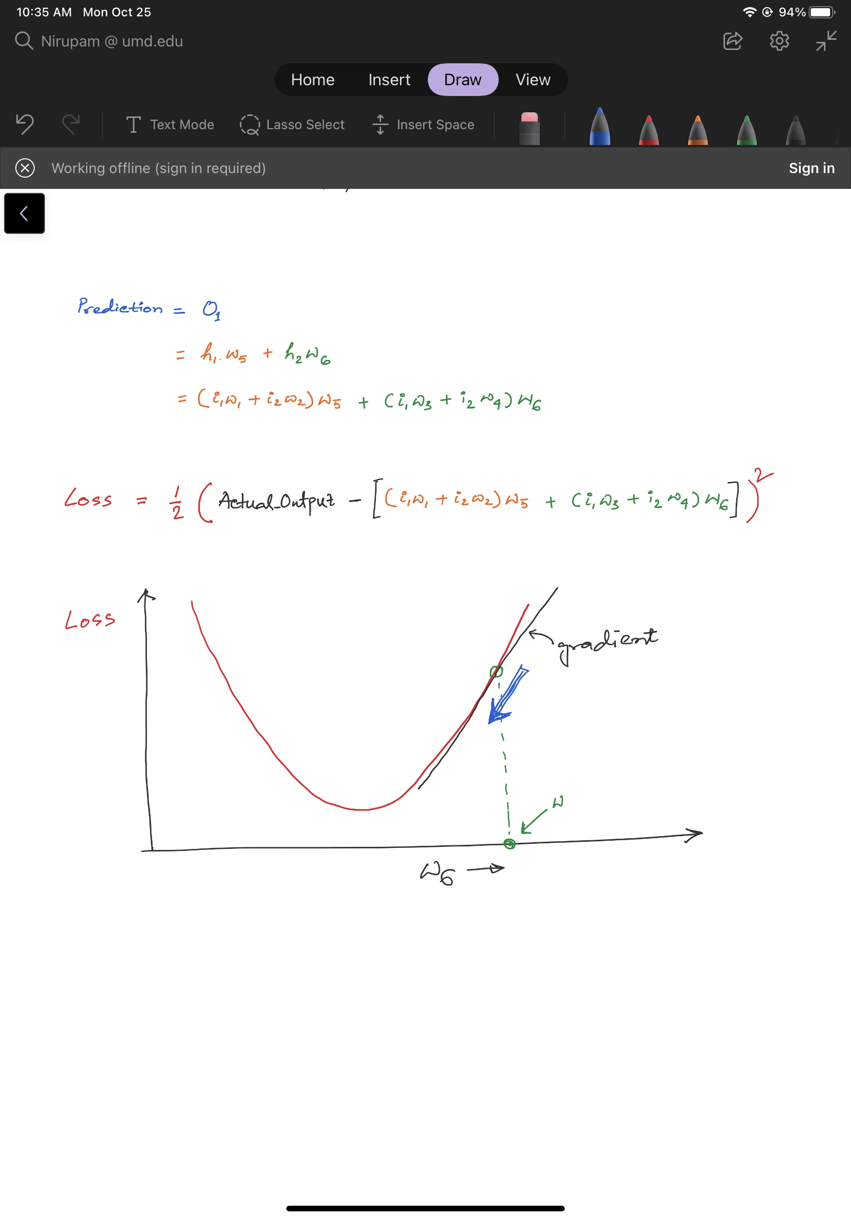
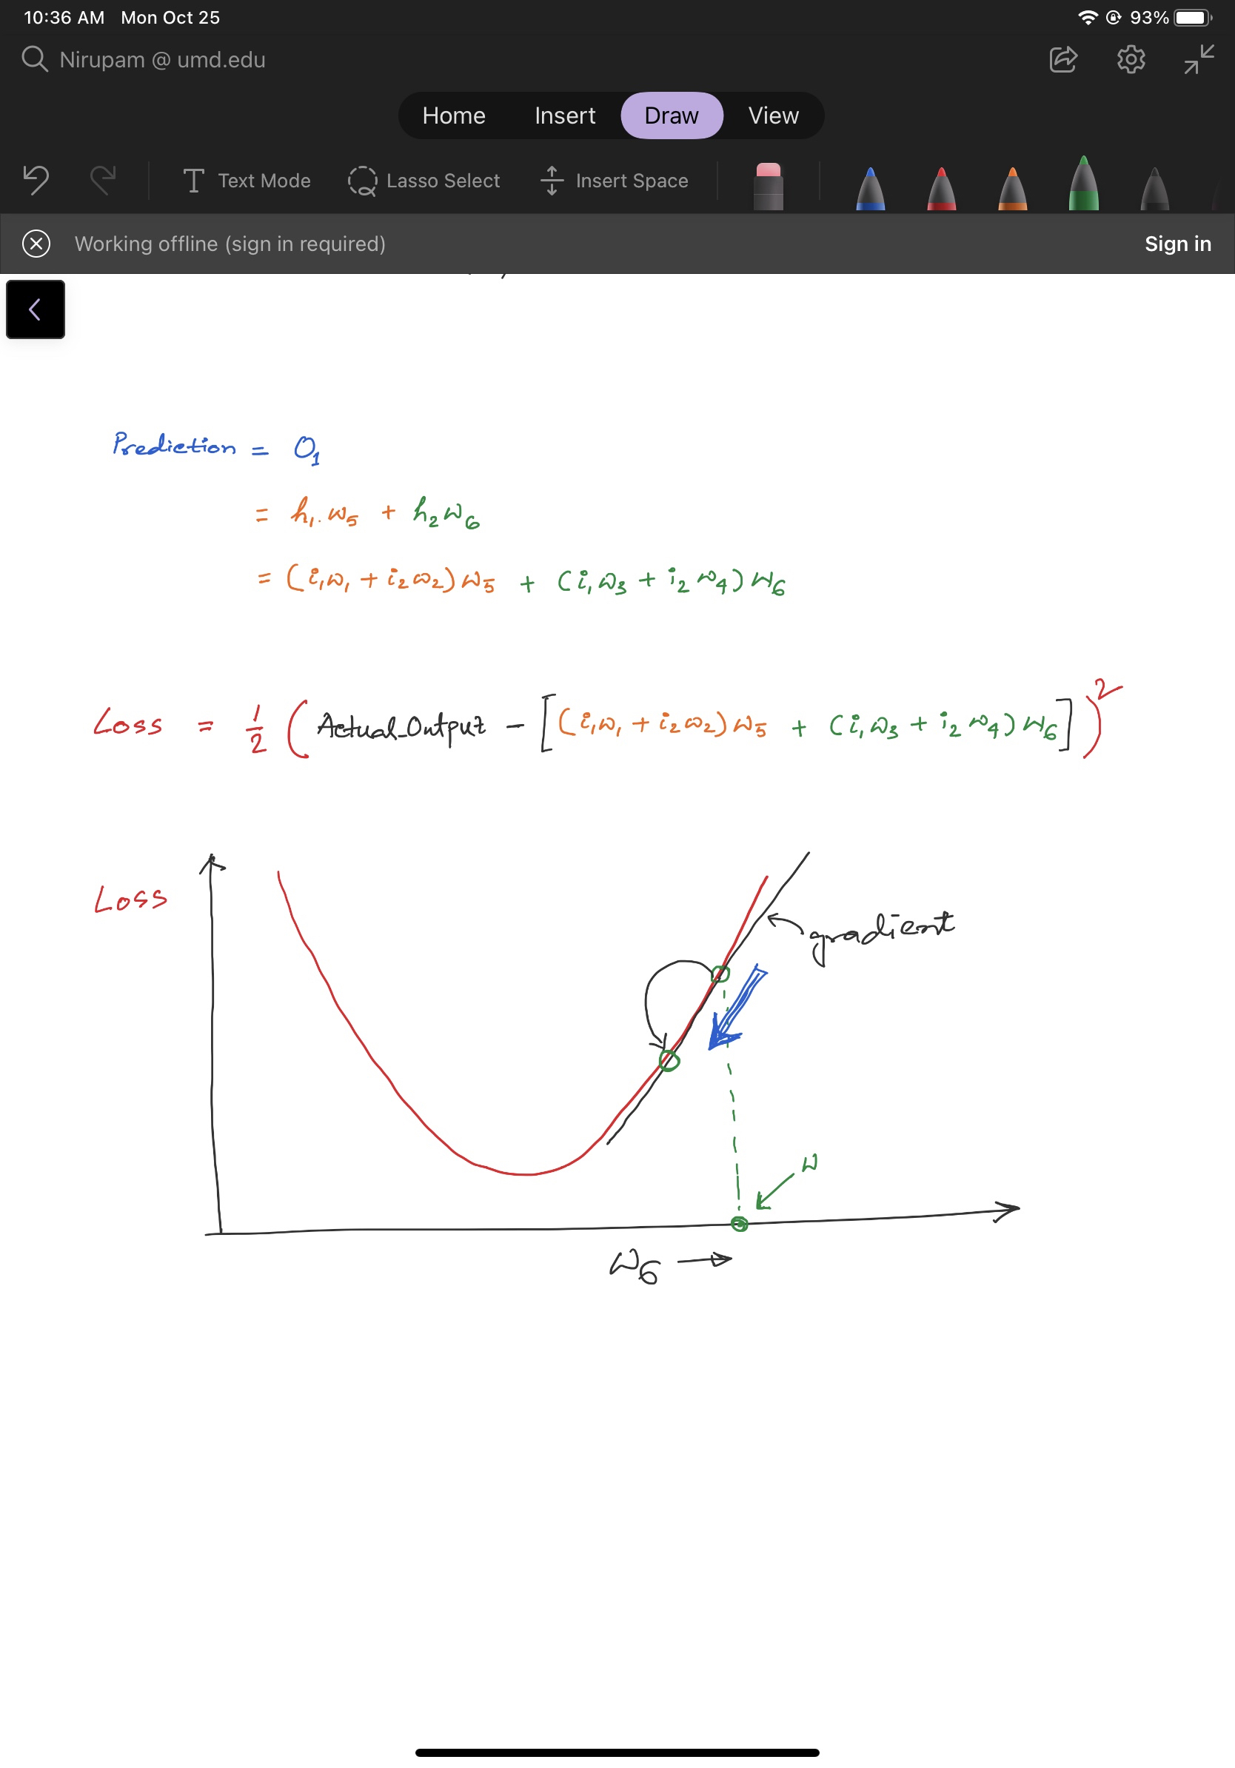
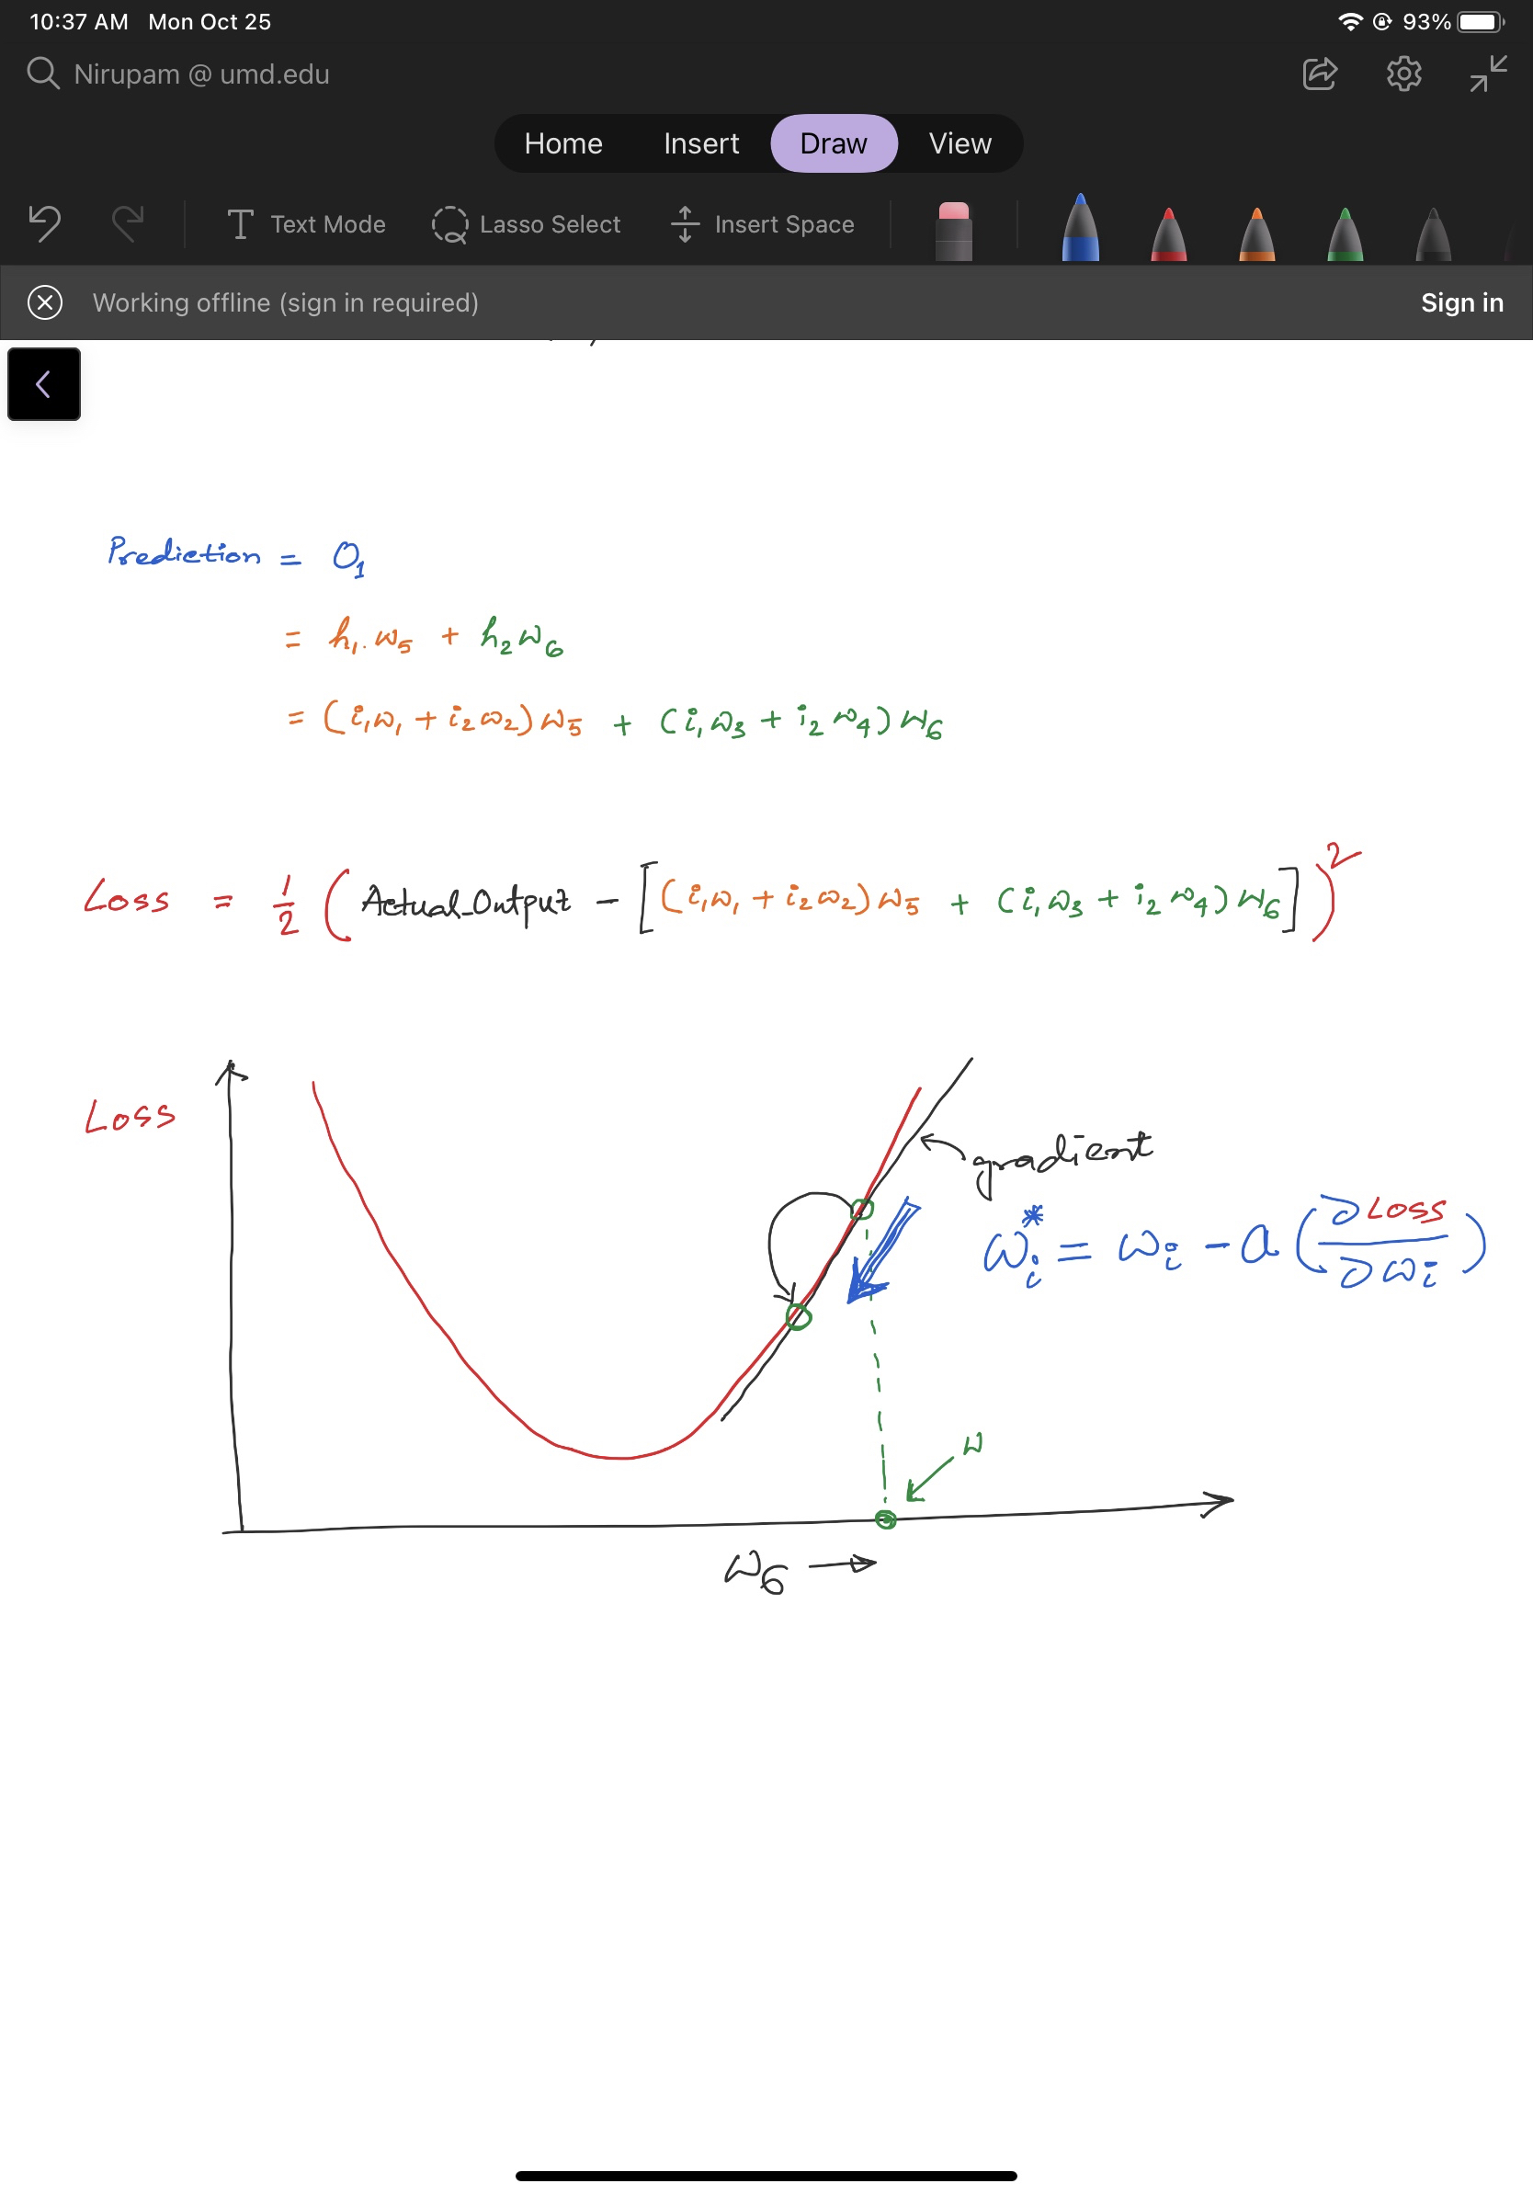
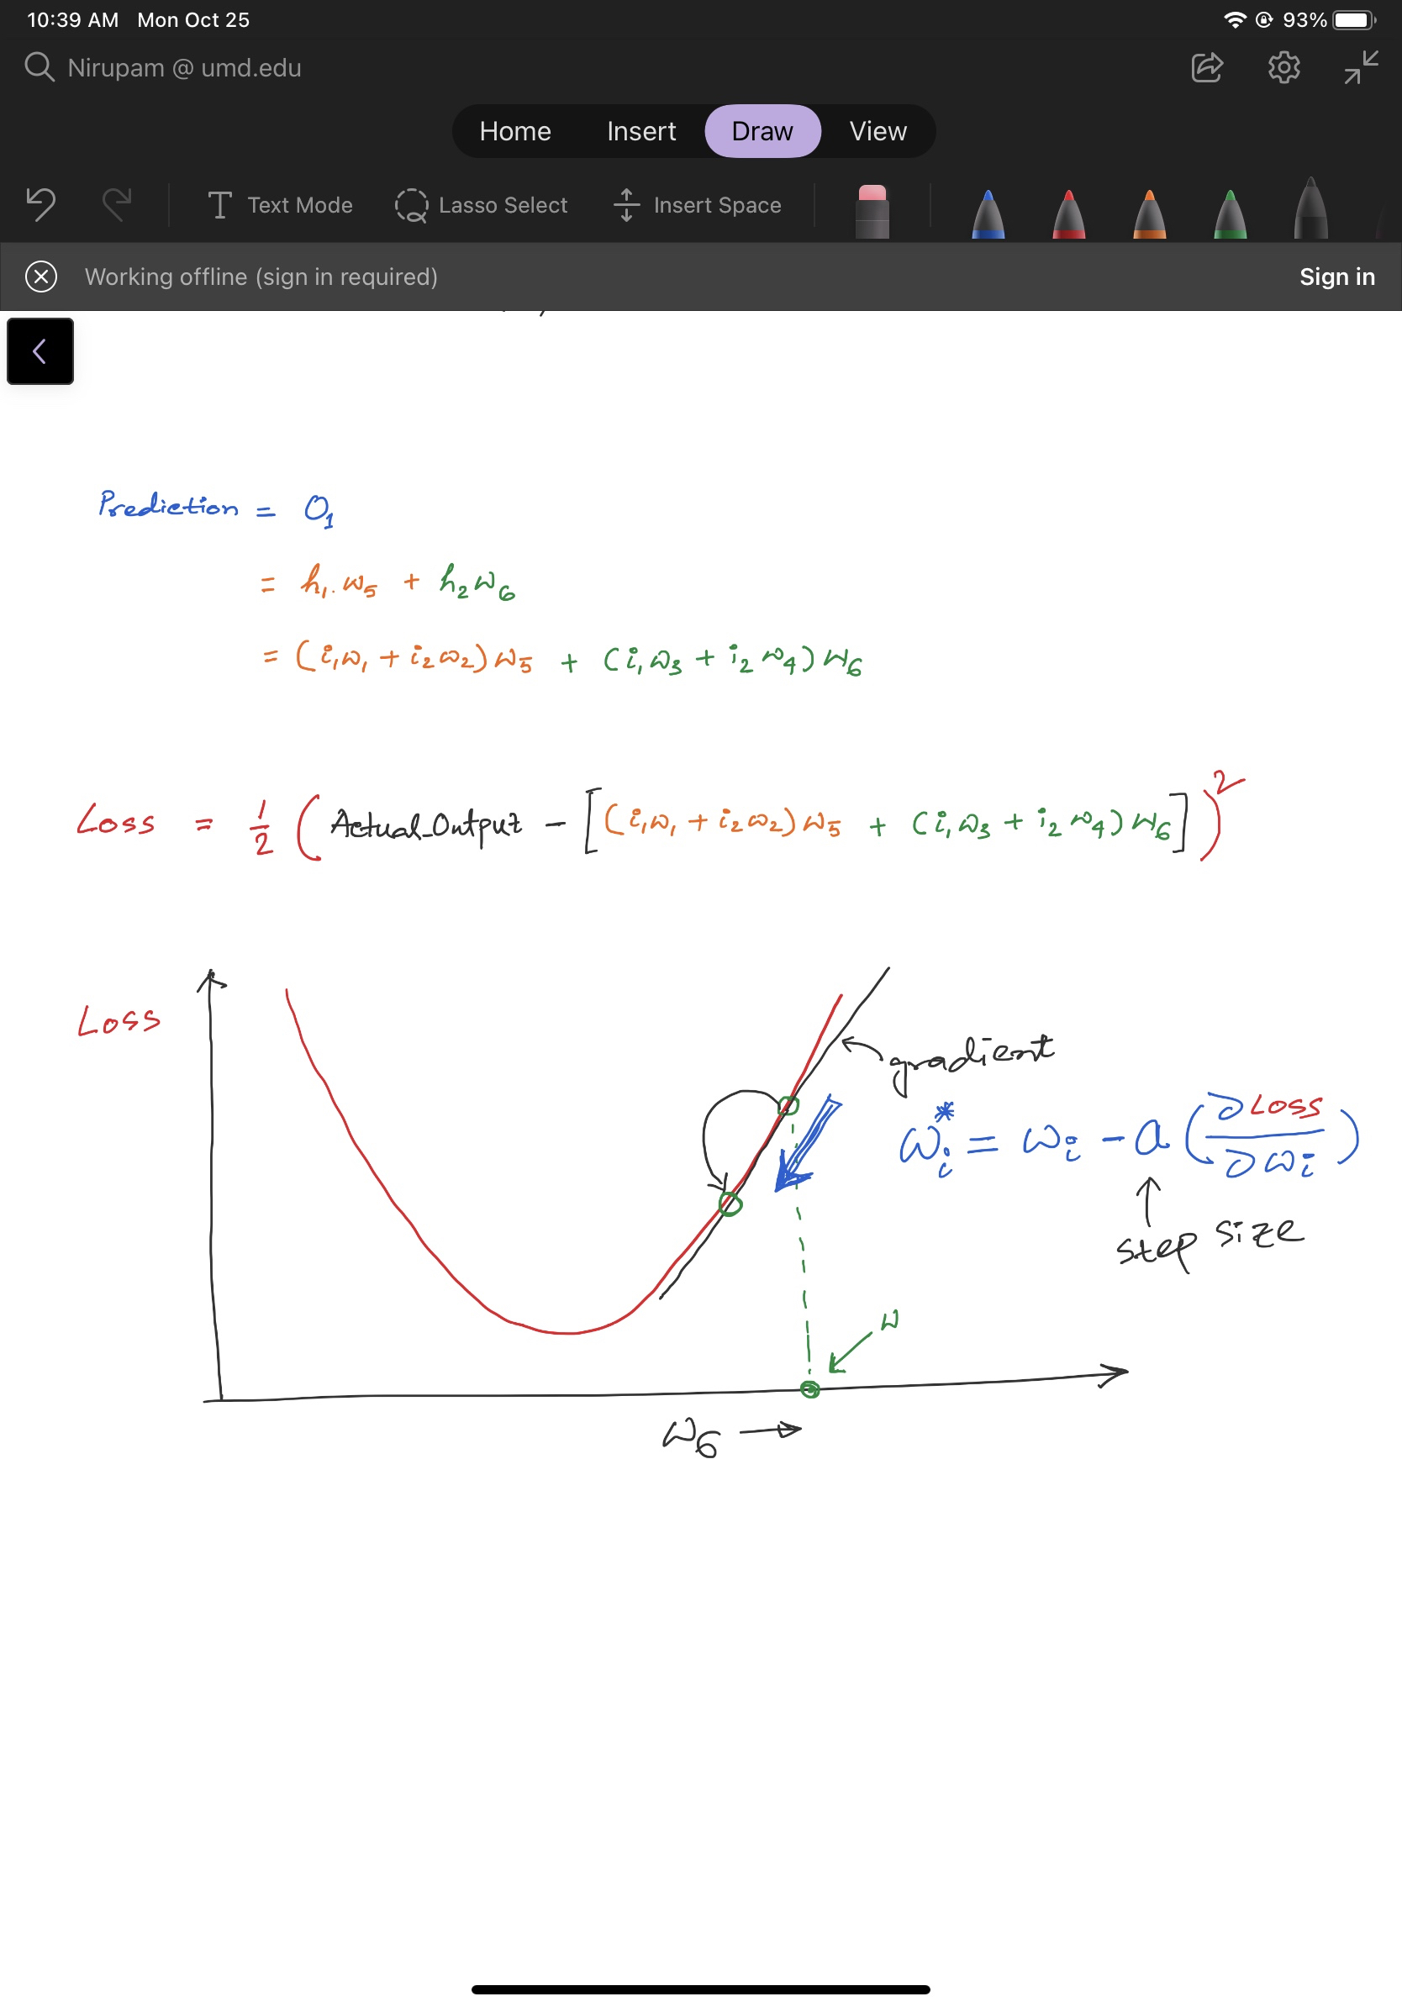
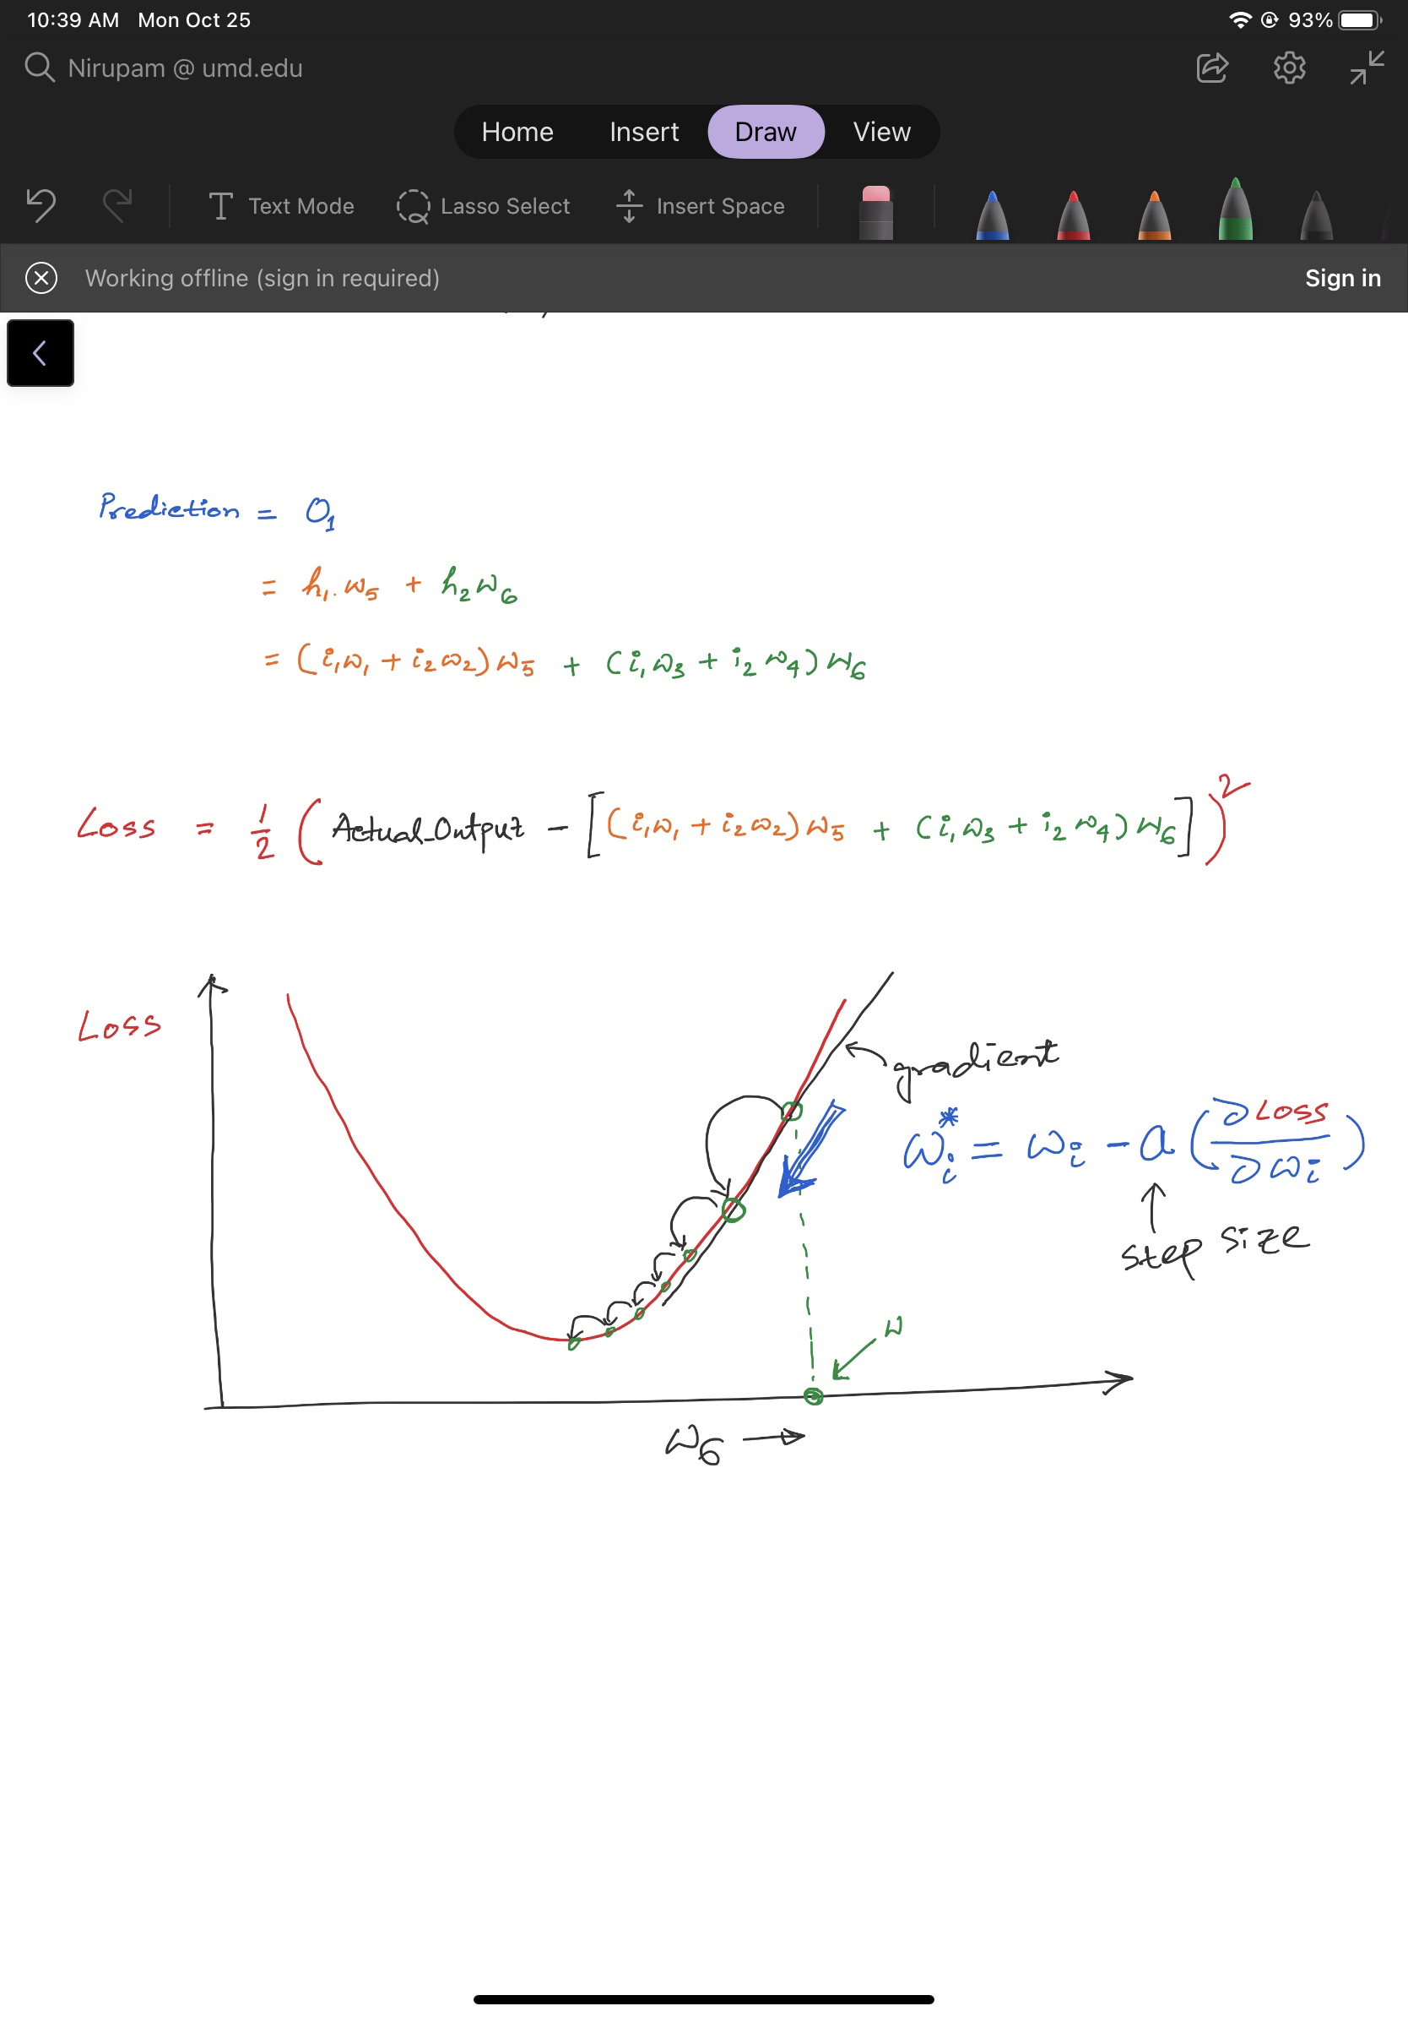
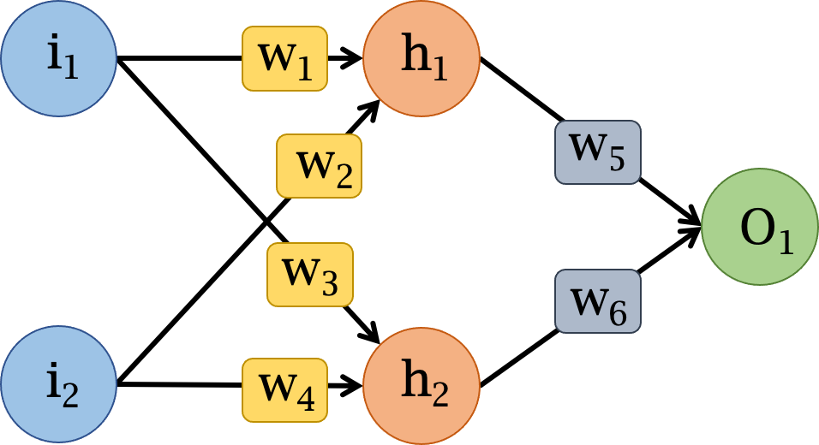

Slide 15
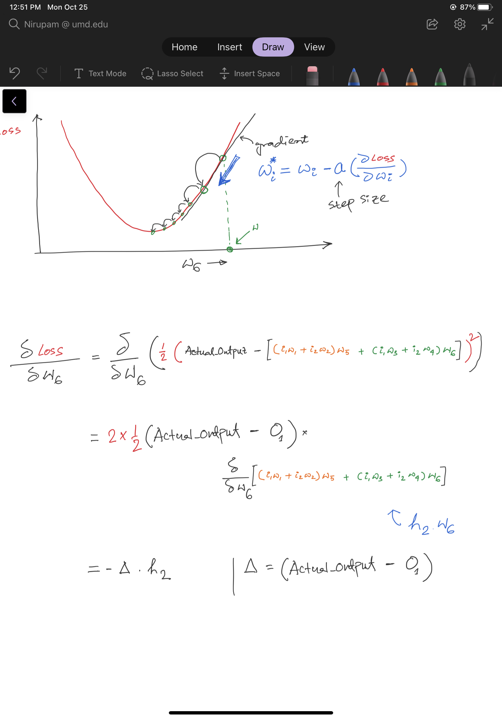

Slide 18
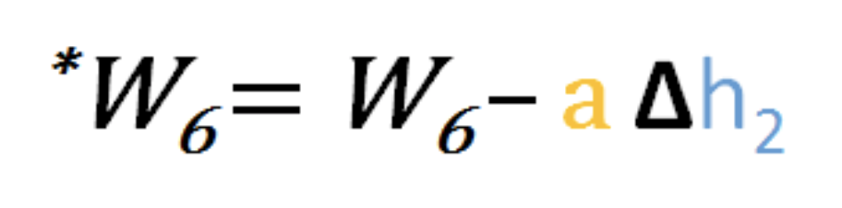

Slide 19
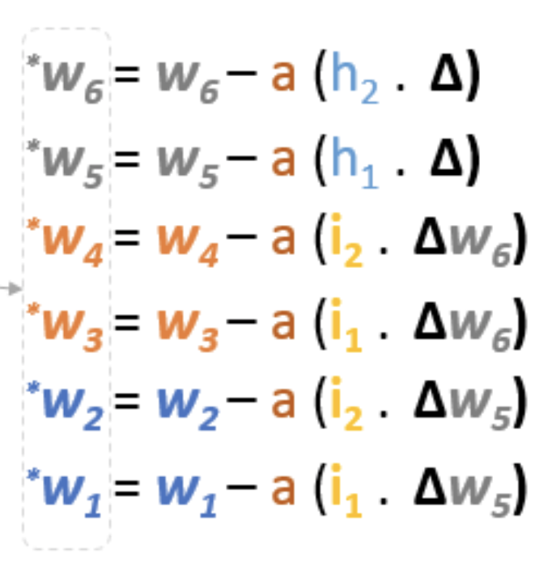
Ref: https://hmkcode.com/ai/backpropagation-step-by-step/

Slide 20
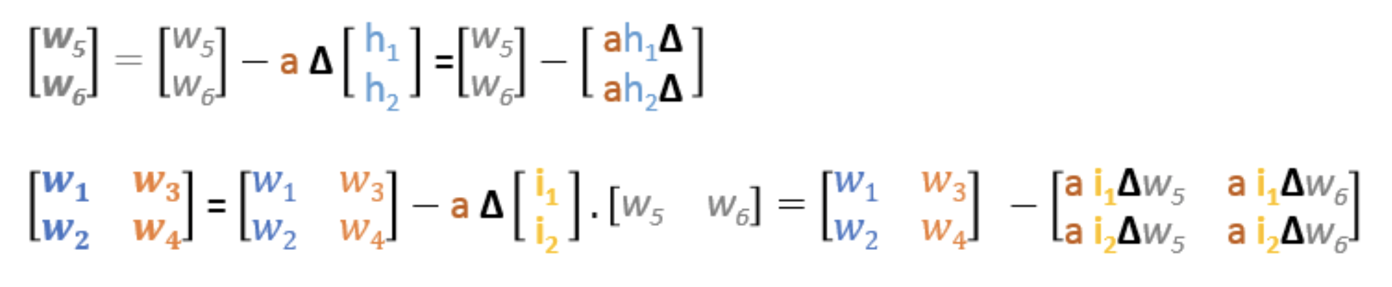
i₁
w₁
h₁
w₅
w₂
O₁
w₃
w₆
i₂
w₄
h₂

Slide 21
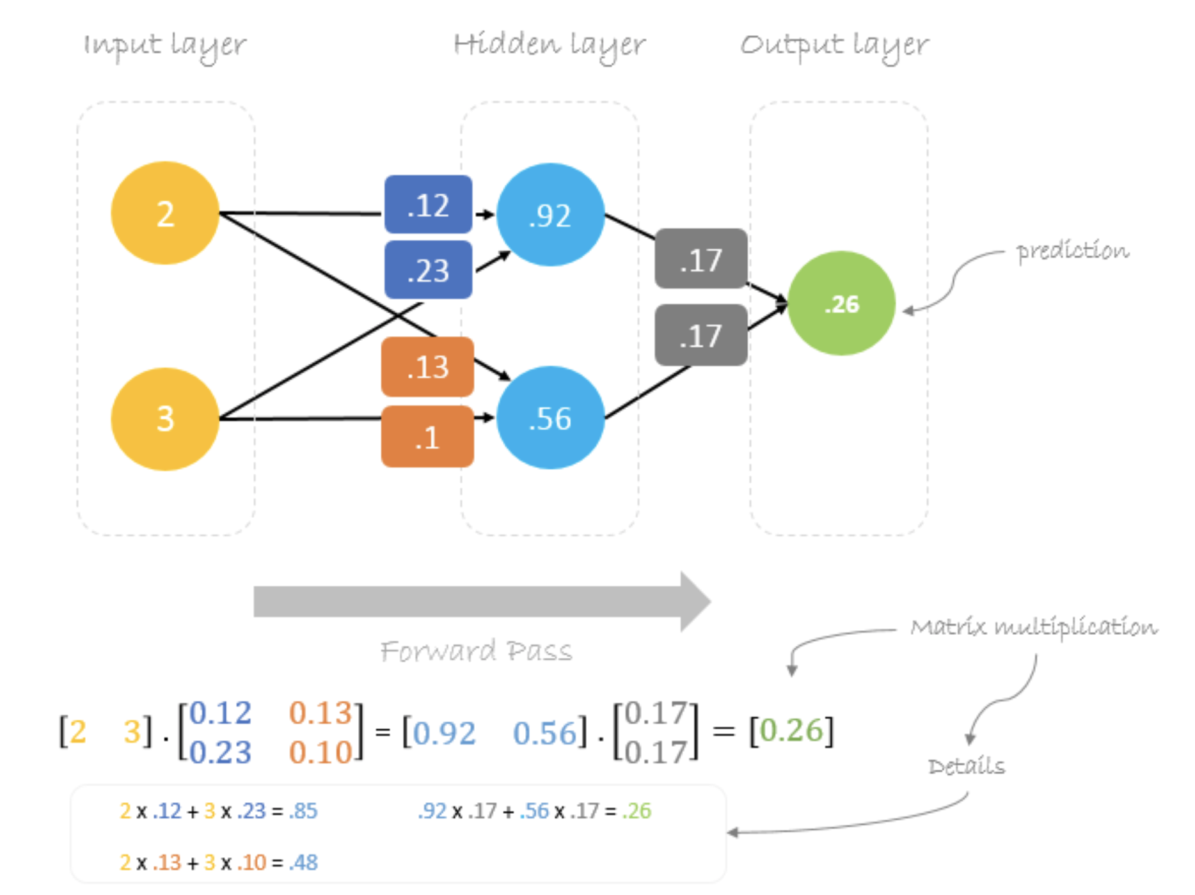

Slide 22
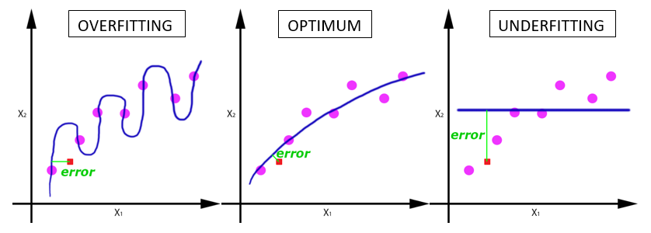
Deep learning terminologies
5. Epoch, Batches, Batch size, Iteration
a. Epoch:
-Entire dataset is passed (forward and backward) through the network.
-Why do we need multiple epochs?
How to find the right number of epochs?
Notes:
Ref: https://www.analyticsvidhya.com/blog/2019/08/detailed-guide-7-loss-functions-machine-learning-python-code/

Slide 23
Deep learning terminologies
5. Epoch, Batches, Batch size, Iteration
a. Epoch:
-Entire dataset is passed (forward and backward) through the network.
b. Batch/Batch size:
-Large data set is divided into smaller chunks or batches of specific size.
Notes:
Ref: https://www.analyticsvidhya.com/blog/2019/08/detailed-guide-7-loss-functions-machine-learning-python-code/

Slide 24
Deep learning terminologies
5. Epoch, Batches, Batch size, Iteration
a. Epoch:
-Entire dataset is passed (forward and backward) through the network.
b. Batch/Batch size:
-Large data set is divided into smaller chunks or batches of specific size.
c. Iteration:
-Number of batches required to complete one epoch.
Notes:
Ref: https://www.analyticsvidhya.com/blog/2019/08/detailed-guide-7-loss-functions-machine-learning-python-code/

Slide 25
Deep learning terminologies
5. Epoch, Batches, Batch size, Iteration
a. Epoch:
-Entire dataset is passed (forward and backward) through the network.
A dataset of 1000 training examples is divided into batches of 200 examples.
It will take 5 iterations to complete 1 epoch.
b. Batch/Batch size:
-Large data set is divided into smaller chunks or batches of specific size.
c. Iteration:
-Number of batches required to complete one epoch.
Notes:
Ref: https://www.analyticsvidhya.com/blog/2019/08/detailed-guide-7-loss-functions-machine-learning-python-code/

Slide 26

Deep learning terminologies
6. Cross-validation
Notes:
PC: https://en.wikipedia.org/wiki/Cross-validation_(statistics)

Slide 27
Types of learning problems
1. Supervised
a. Classification
b. Regression
2. Unsupervised
a. Clustering
b. Association
3. Reinforcement

Slide 28
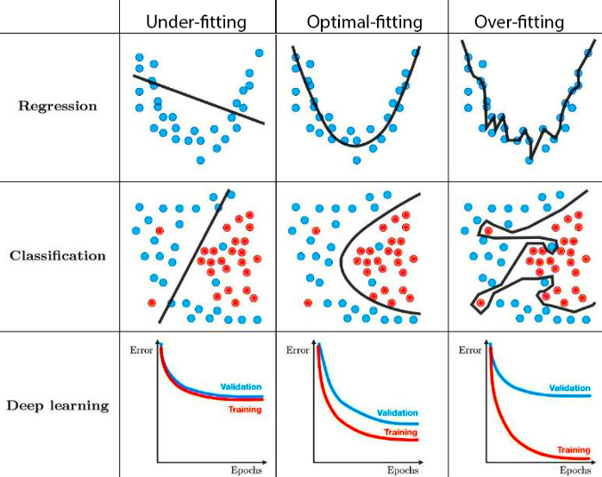
Challenges: Underfitting & Overfitting
Notes:
PC: https://towardsdatascience.com/techniques-for-handling-underfitting-and-overfitting-in-machine-learning-348daa2380b9

Slide 29
Dealing with underfitting
a. Increase model complexity
b. Use more epochs for training
c. Shuffle data per epoch
Notes:
https://towardsdatascience.com/techniques-for-handling-underfitting-and-overfitting-in-machine-learning-348daa2380b9

Slide 30
Dealing with overfitting
a. Increase training dataset
Regularization
a. Dropout
b. Augmentation
c. Early stopping
Notes:
https://towardsdatascience.com/techniques-for-handling-underfitting-and-overfitting-in-machine-learning-348daa2380b9

Slide 31
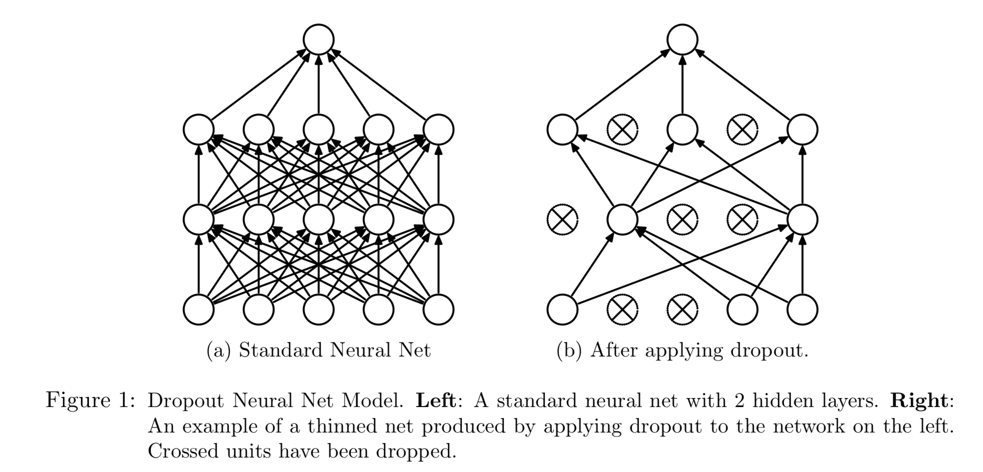
Dealing with overfitting
a. Dropout
Ref: Dropout: A Simple Way to Prevent Neural Networks from Overfitting
https://www.cs.toronto.edu/~hinton/absps/JMLRdropout.pdf
Notes:
DropConnect

Slide 32
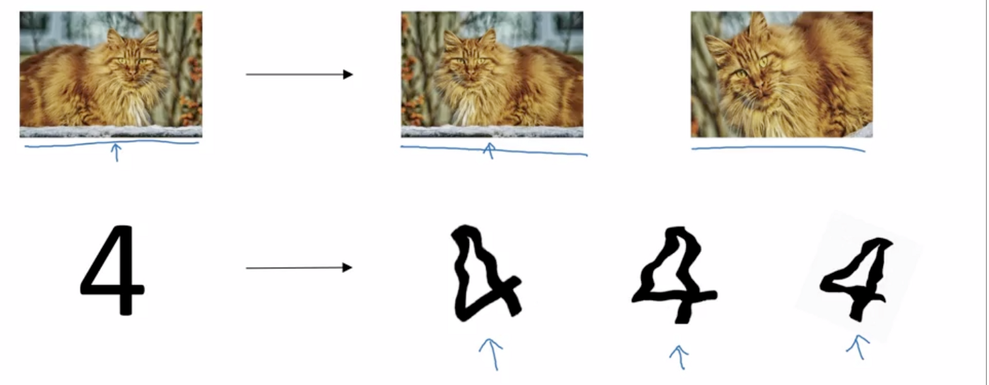
Dealing with overfitting
b. Augmentation
Notes:
https://medium.com/@dhartidhami/regularization-in-deep-learning-2065b7c889e5

Slide 33
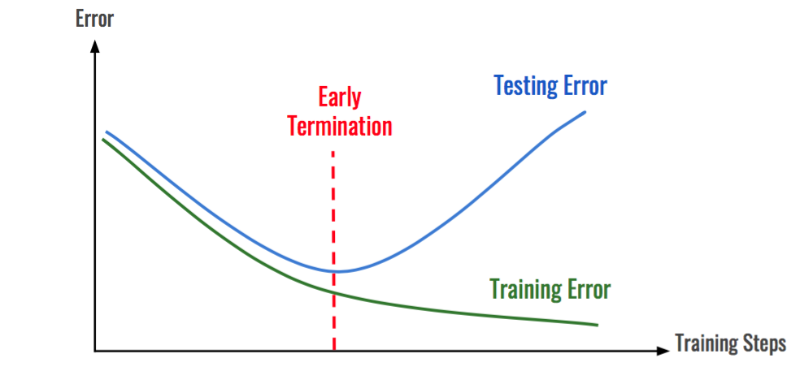
Dealing with overfitting
c. Early stopping

Slide 34
Deep learning on Mobile/Embedded devices: Challenges
Ref: https://www.edx.org/professional-certificate/harvardx-tiny-machine-learning

Slide 35
Microprocessor vs Microcontroller

Slide 36
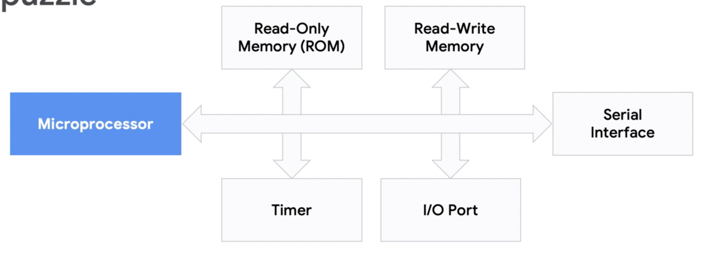
Microprocessor vs Microcontroller

Slide 37
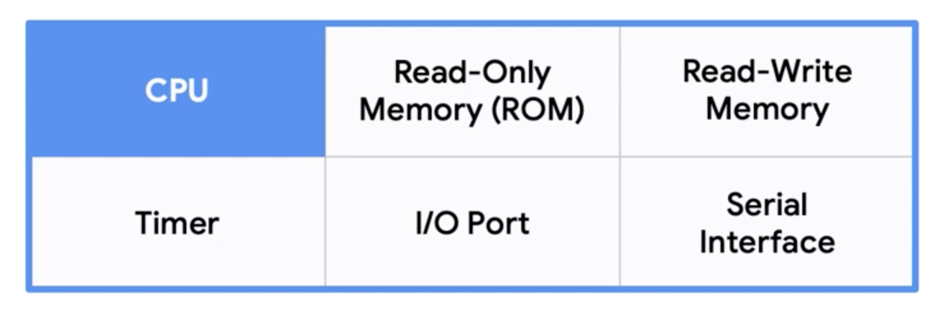
Microprocessor vs Microcontroller
Microcontroller

Slide 38
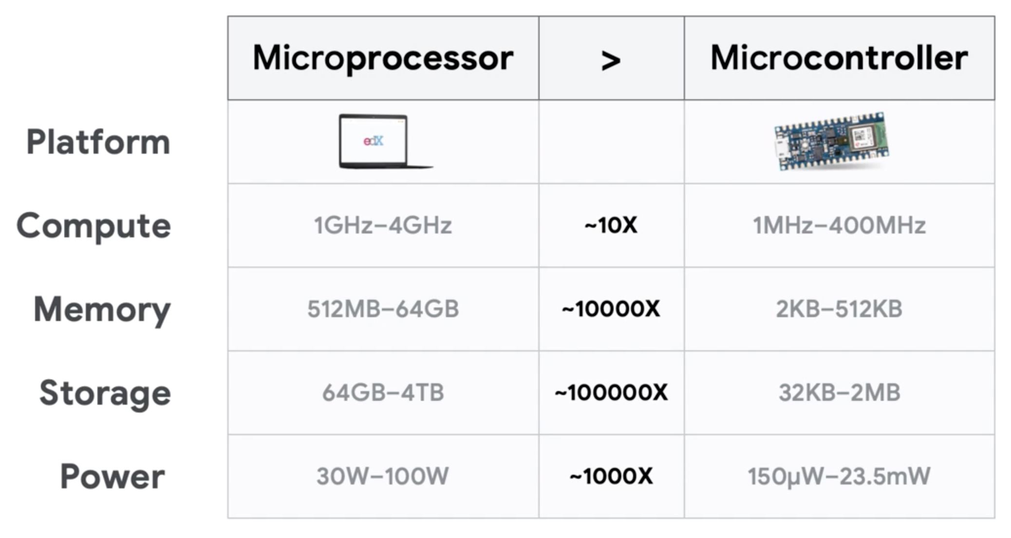
Microprocessor vs Microcontroller
Ref: https://www.edx.org/professional-certificate/harvardx-tiny-machine-learning

Slide 39
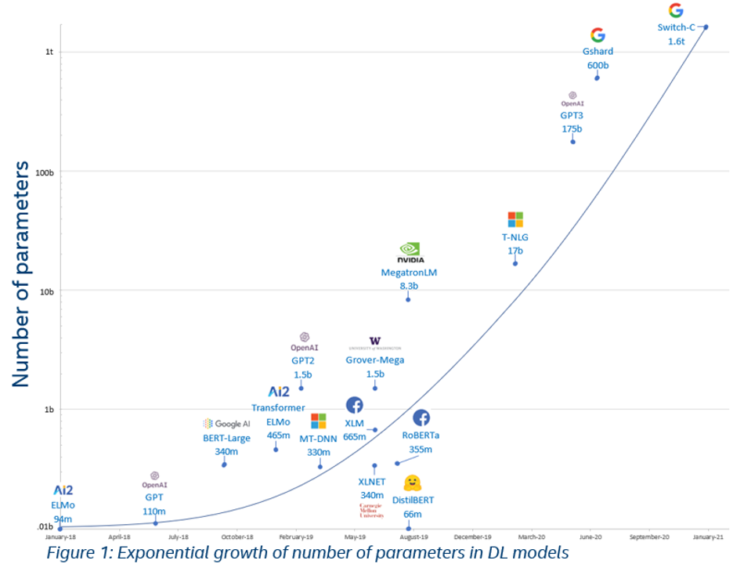

Slide 40
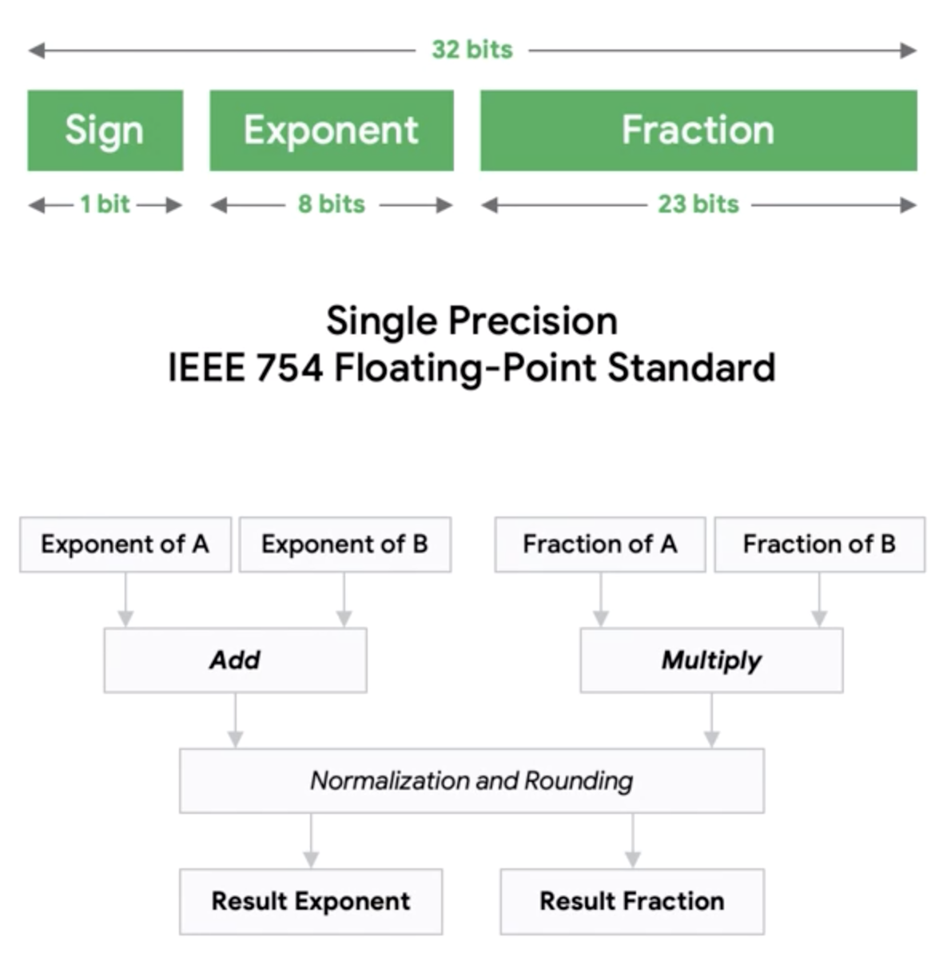
Microprocessor vs Microcontroller
Floating point operation
Ref: https://www.edx.org/professional-certificate/harvardx-tiny-machine-learning

Slide 41
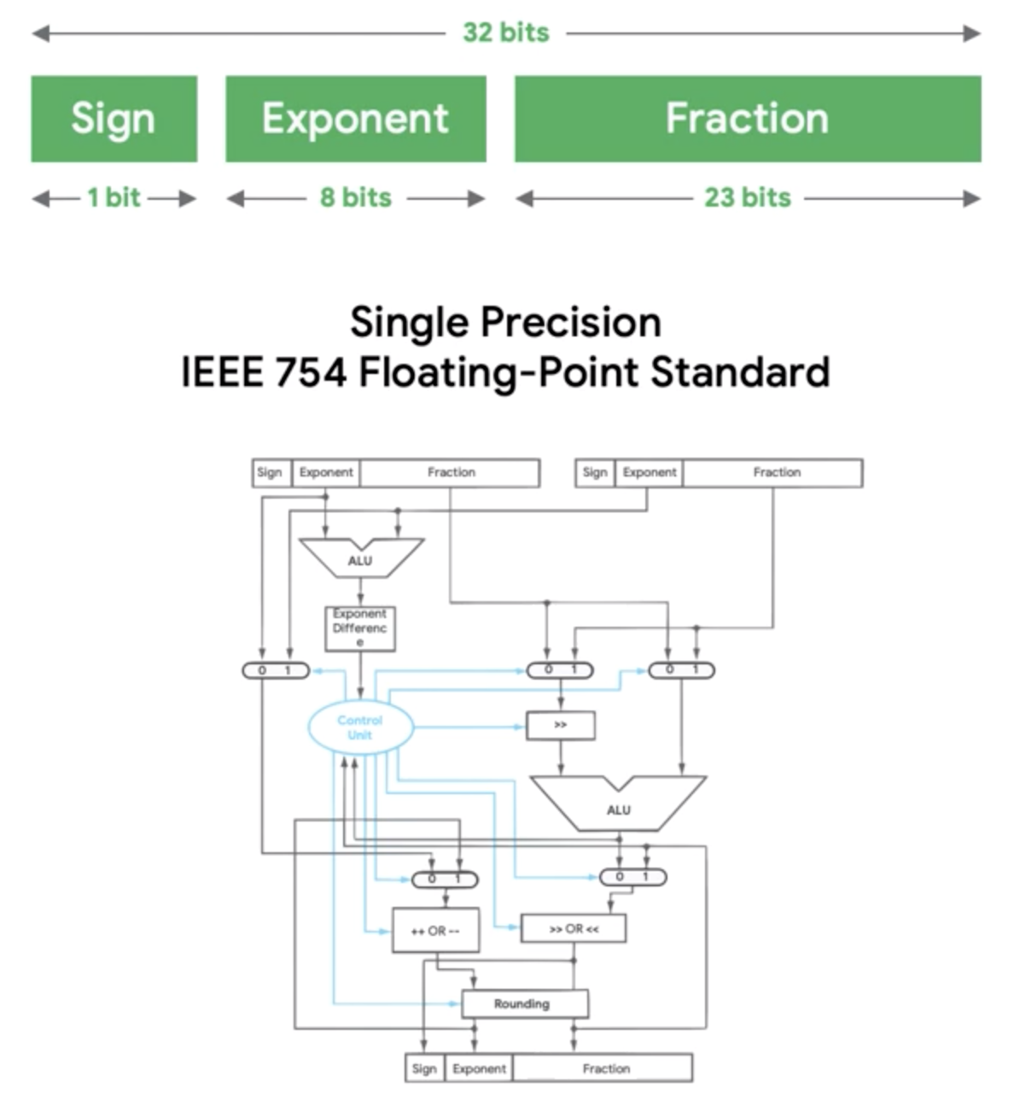
Microprocessor vs Microcontroller
Floating point operation
Ref: https://www.edx.org/professional-certificate/harvardx-tiny-machine-learning

Slide 42
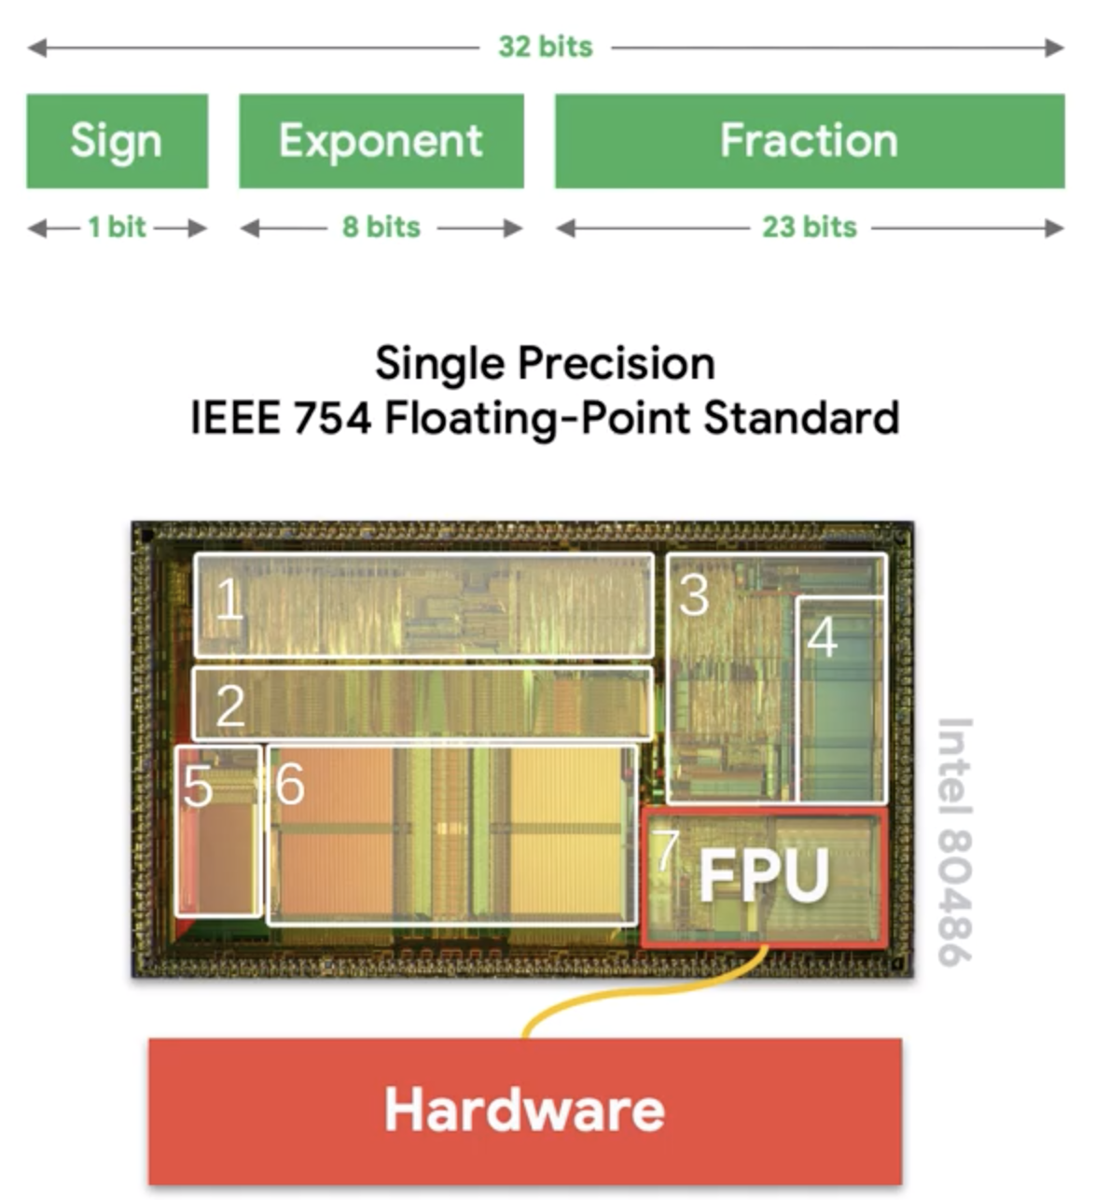
Microprocessor vs Microcontroller
Floating point operation
Ref: https://www.edx.org/professional-certificate/harvardx-tiny-machine-learning

Slide 43
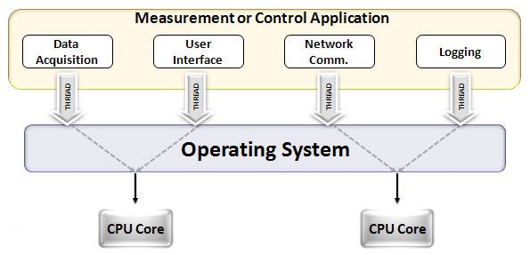
CPU vs GPU
Notes:
https://www.analyticsvidhya.com/blog/2020/09/why-gpus-are-more-suited-for-deep-learning/

Slide 44
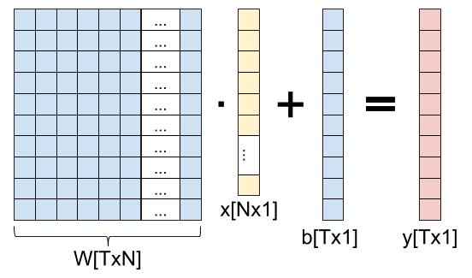
CPU vs GPU for parallel operations
Notes:
https://eli.thegreenplace.net/2018/backpropagation-through-a-fully-connected-layer/

Slide 45
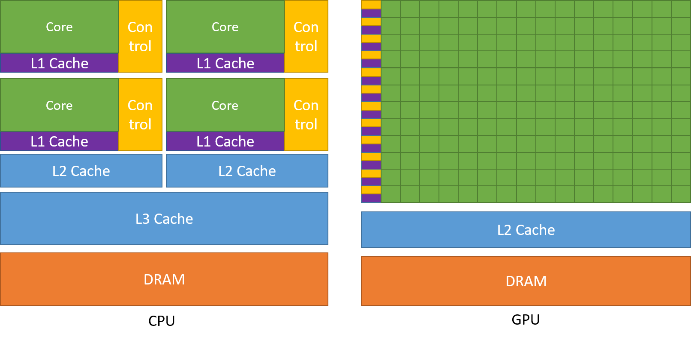
CPU vs GPU
Notes:
https://www.analyticsvidhya.com/blog/2020/09/why-gpus-are-more-suited-for-deep-learning/

Slide 46
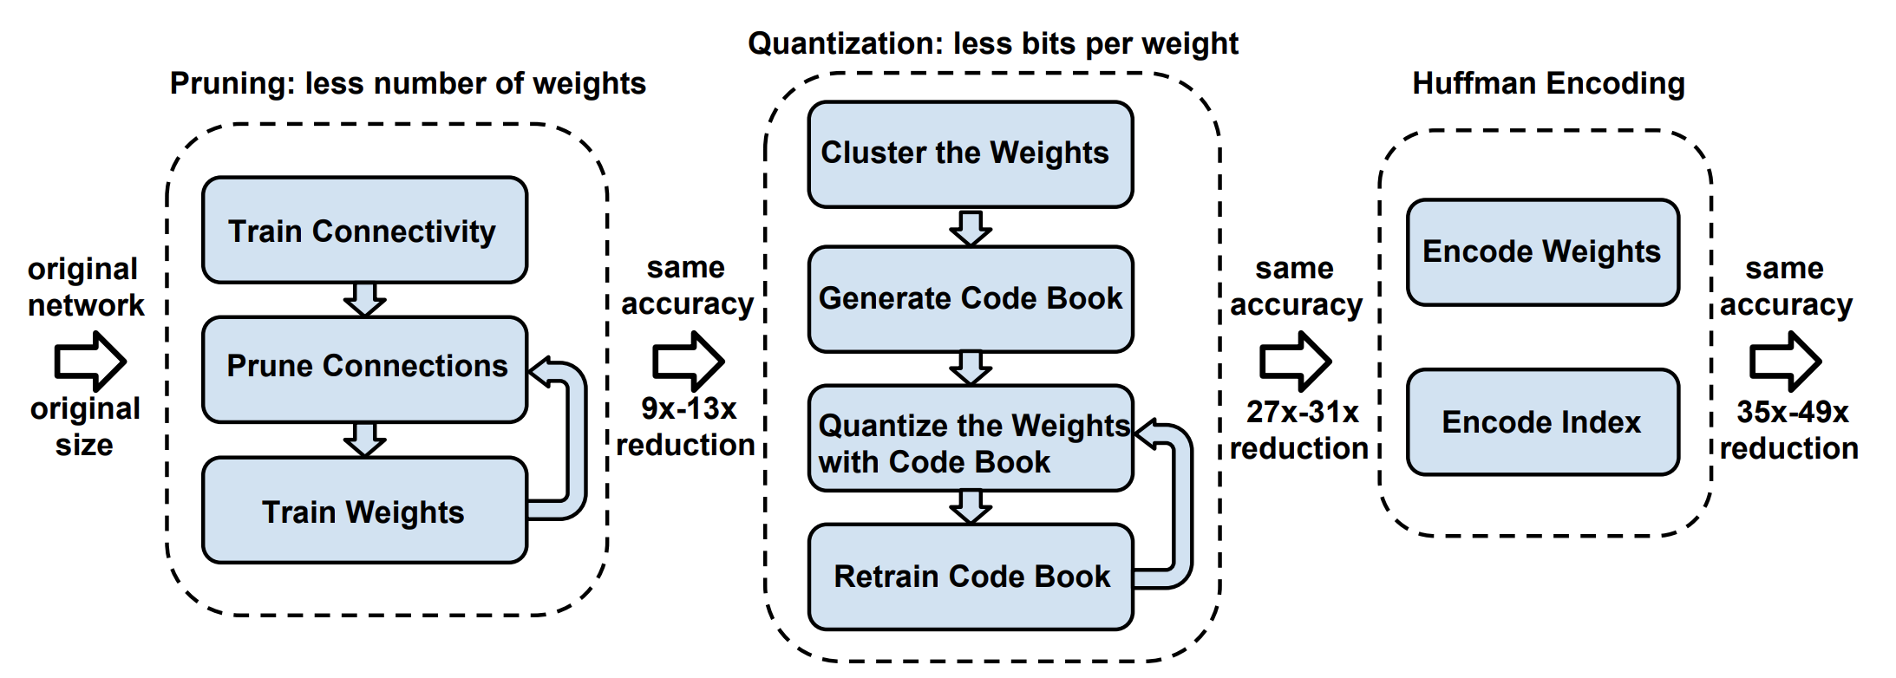
Compression of deep learning models
(TinyML example)
Notes:
https://tutorials.one/tiny-machine-learning/

Slide 47
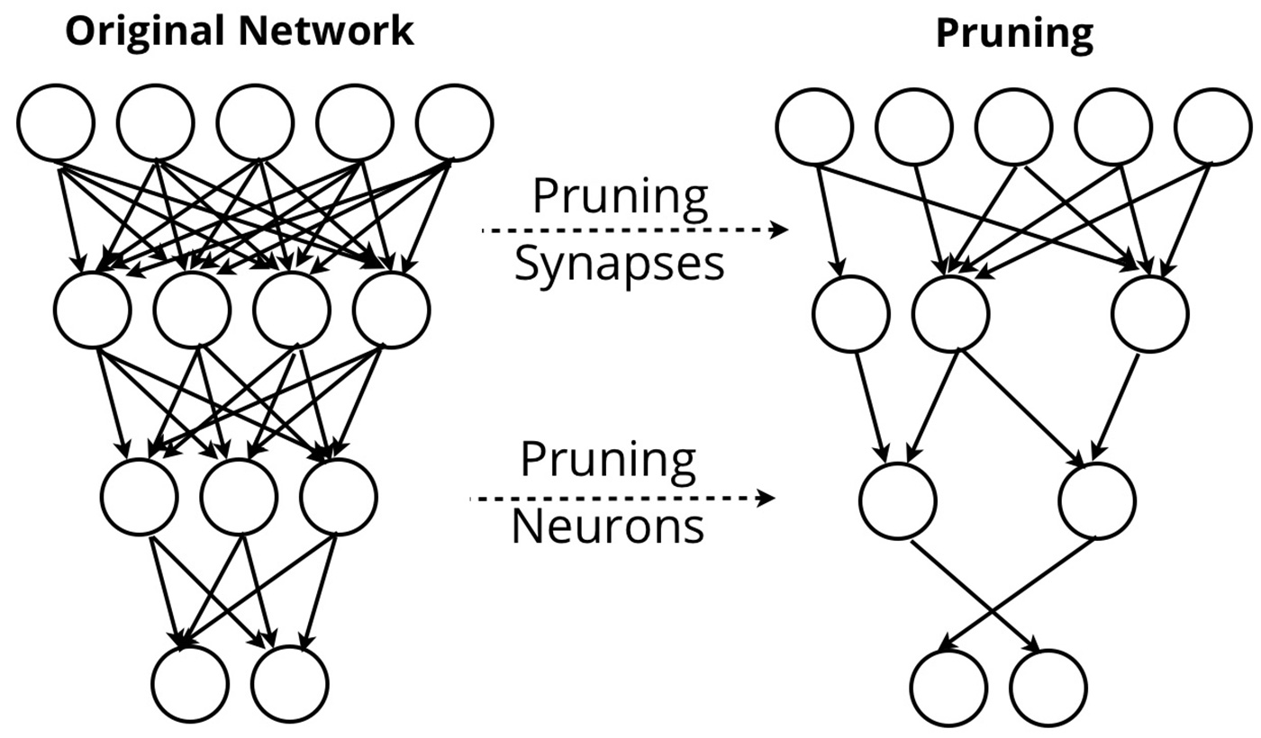
a. Pruning

Slide 48
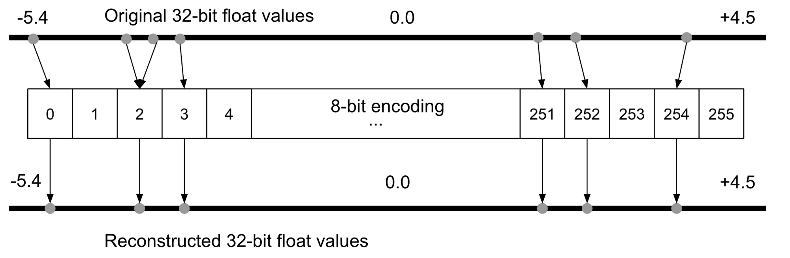
b. Quantization

Slide 49
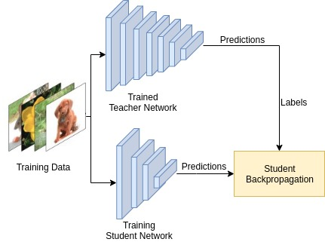
c. Knowledge distillation
Notes:
Paper ref: https://arxiv.org/pdf/2006.05525.pdf

Slide 50
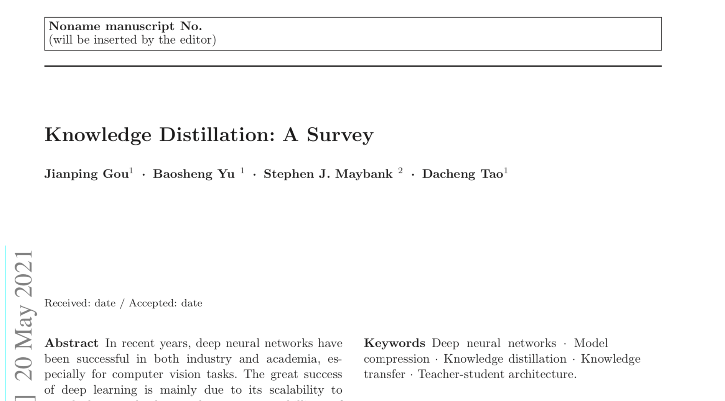
c. Knowledge distillation
Notes:
Paper ref: https://arxiv.org/pdf/2006.05525.pdf

